Slide 1
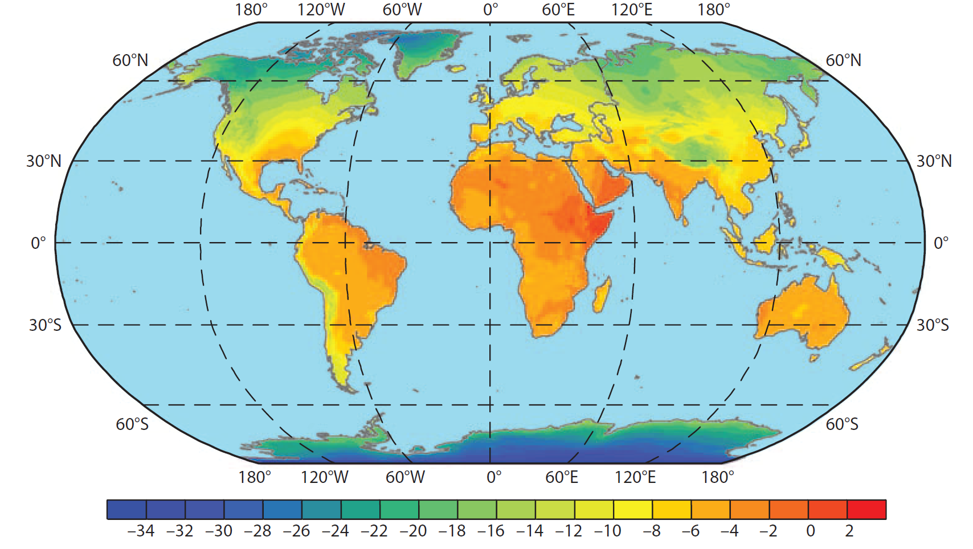

Human Geolocation with Isotopes in assignR
Human Geolocation with Isotopes in assignR
Gabe Bowen
gabe.bowen@utah.edu
Gabe Bowen
gabe.bowen@utah.edu

Slide 2

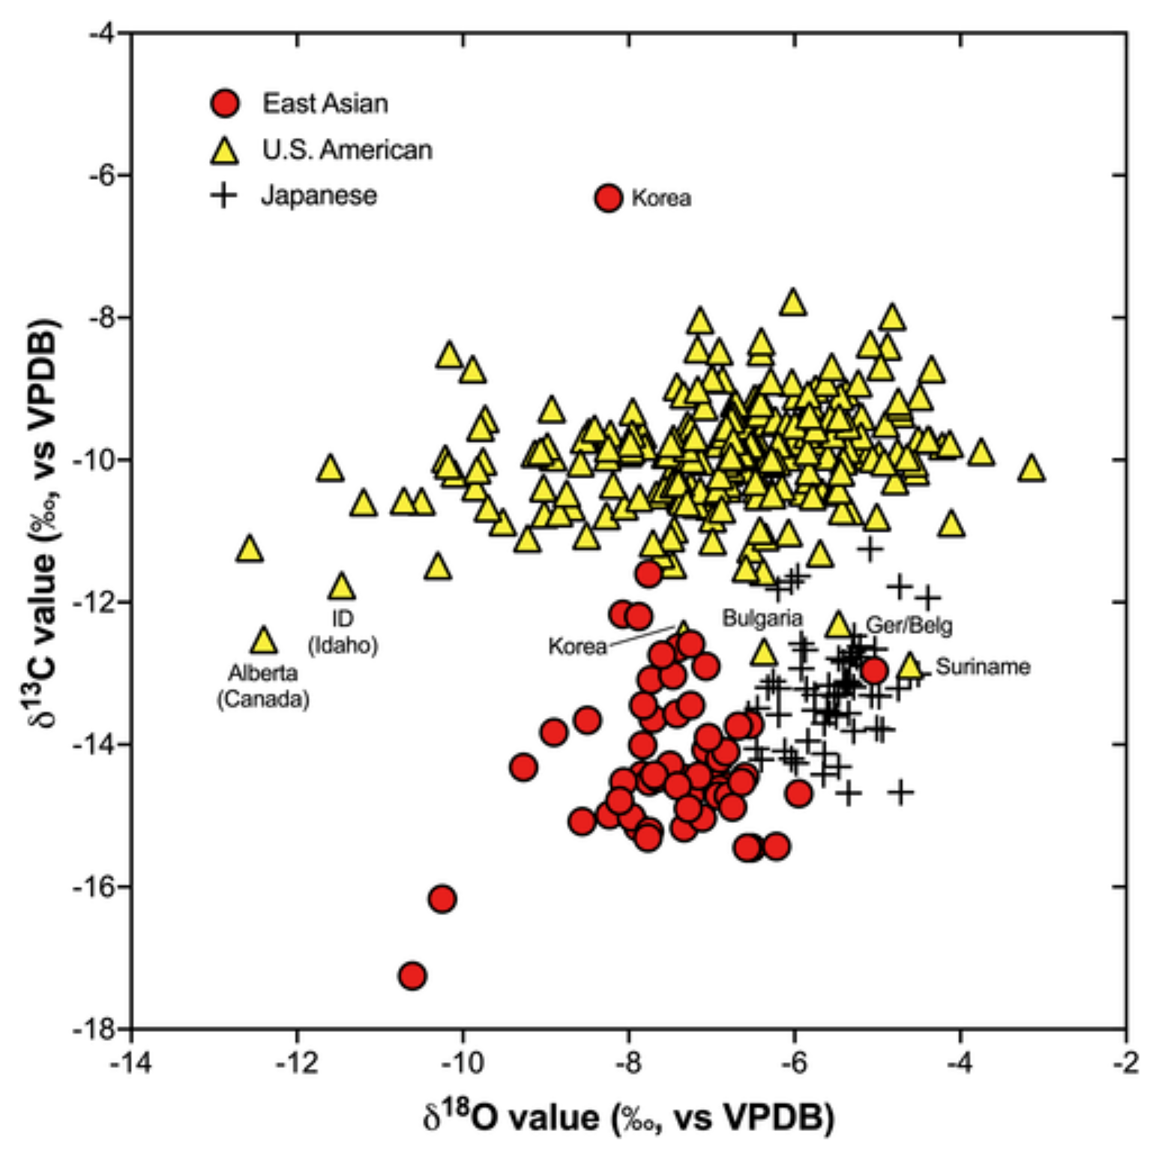
Chesson and Berg, 2022

Slide 3

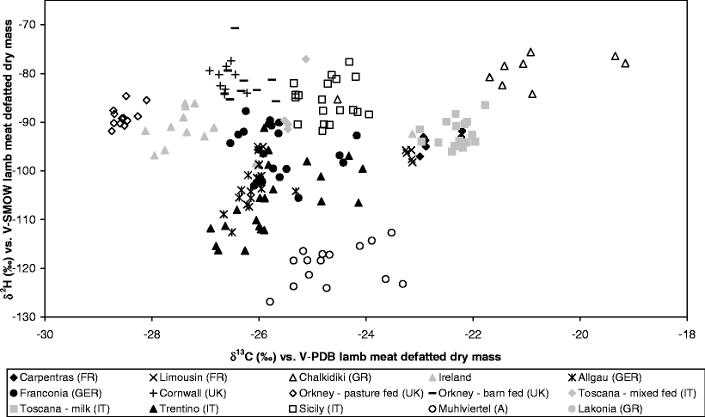
Camin et al., 2007

Slide 4
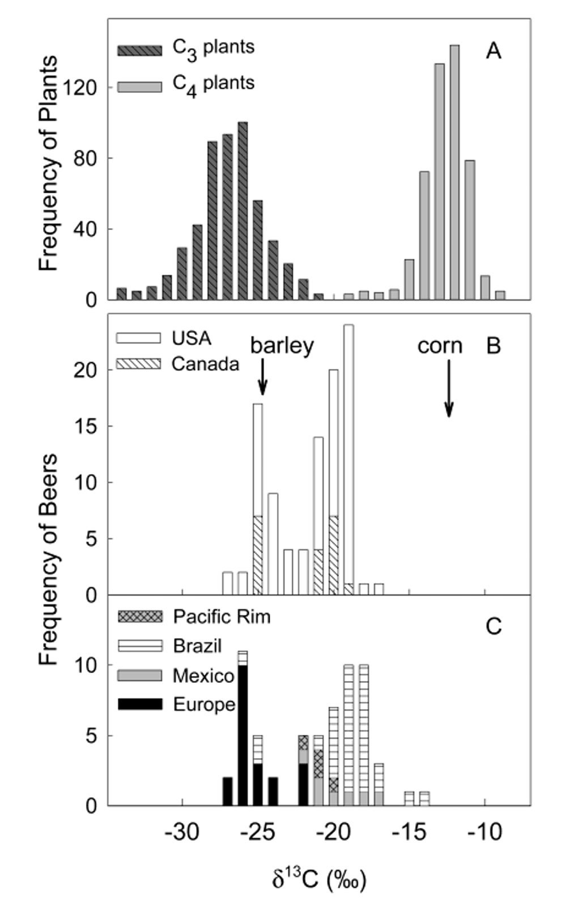

Brooks et al., 2002

Slide 5
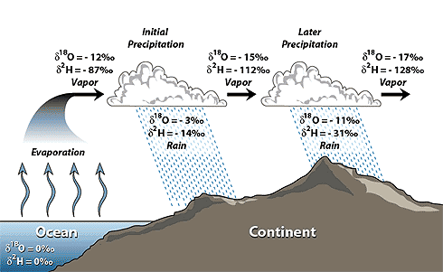
Isotope Fractionation Across Space
http://web.sahra.arizona.edu

Slide 6

Chesson and Berg, 2022

Slide 7
A Framework for Isotopic Geolocation
Where could (or couldn’t) the individual have originated/traveled?
Geographic isotope distributions are governed by fractionation
Fractionation is predictable (not random)
Isoscape: Quantitative model predicting isotope values of a substrate at different locations
At each location on an isoscape we can ask: How likely is it that the individual originated here?

Slide 8
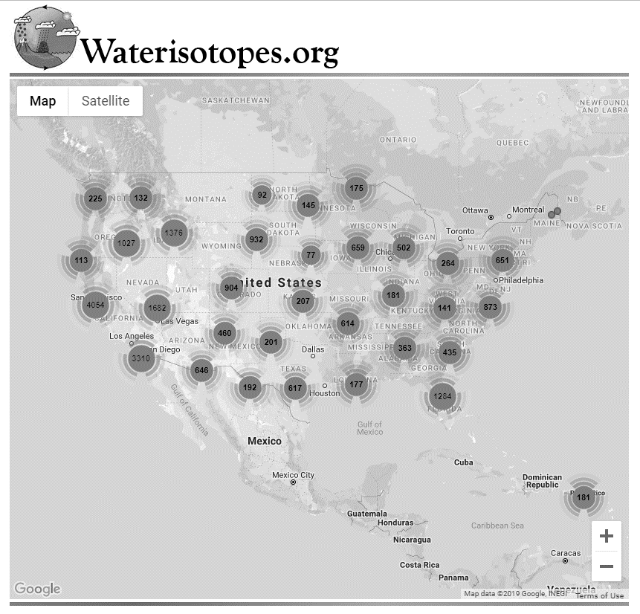
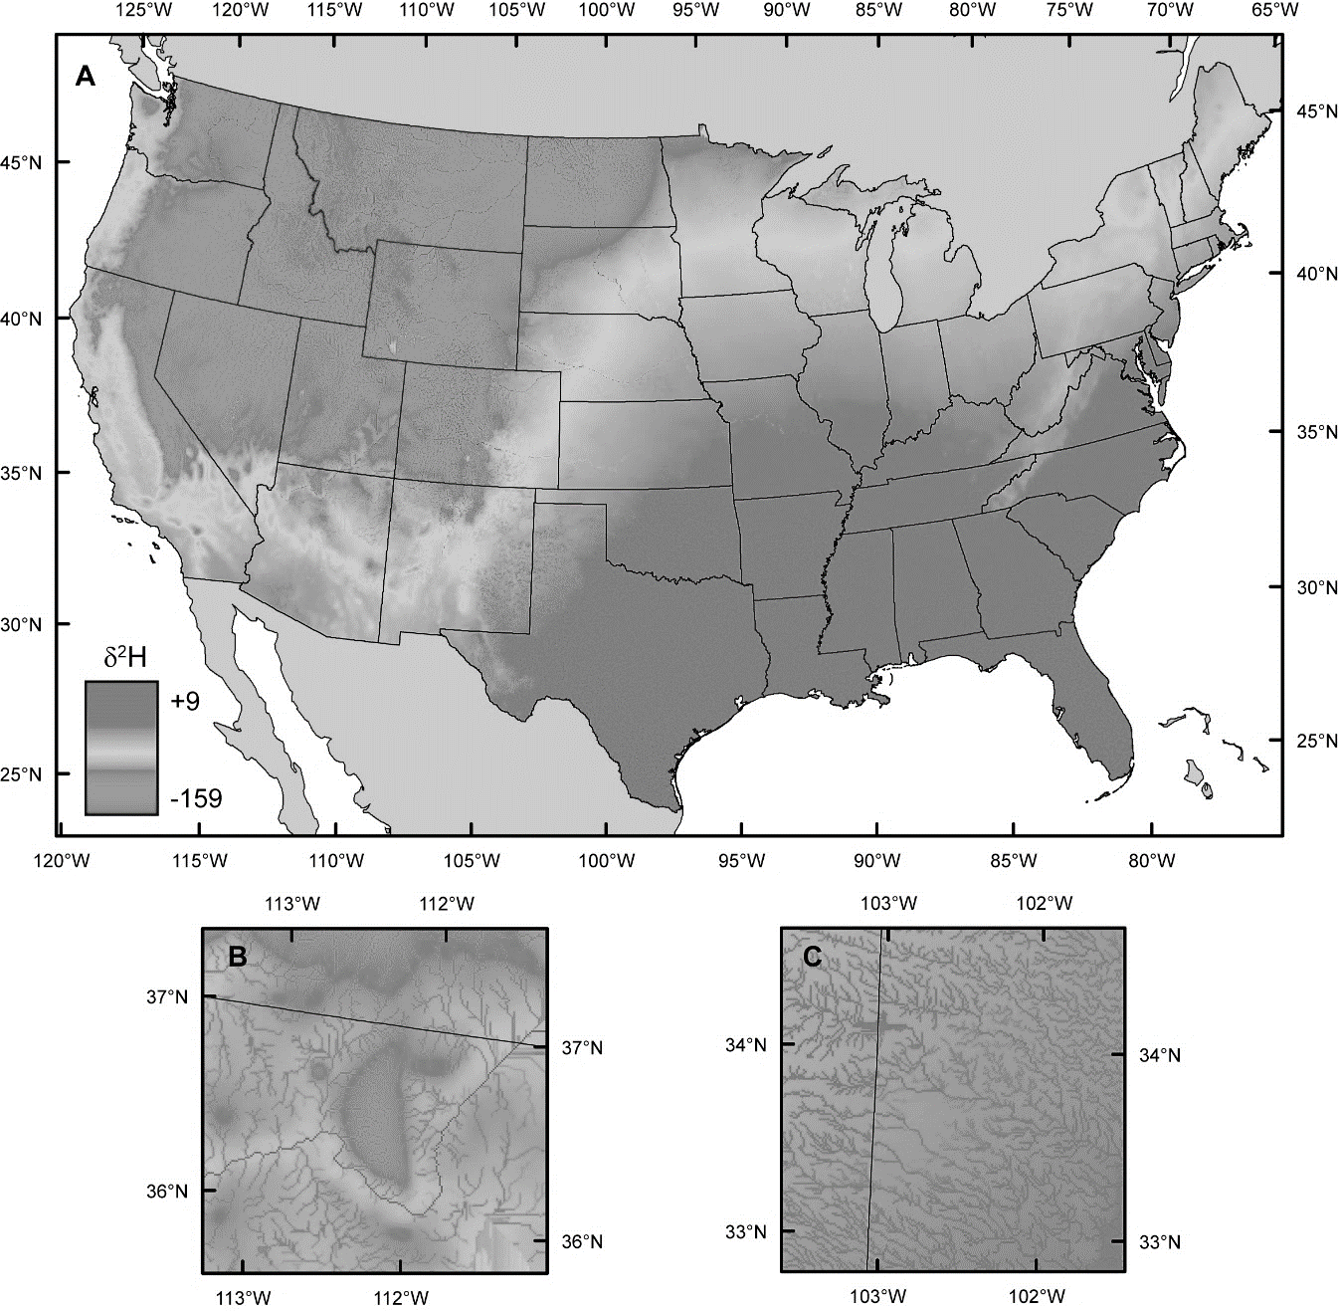
Making Isoscapes
Data
Models

Slide 9







Slide 10
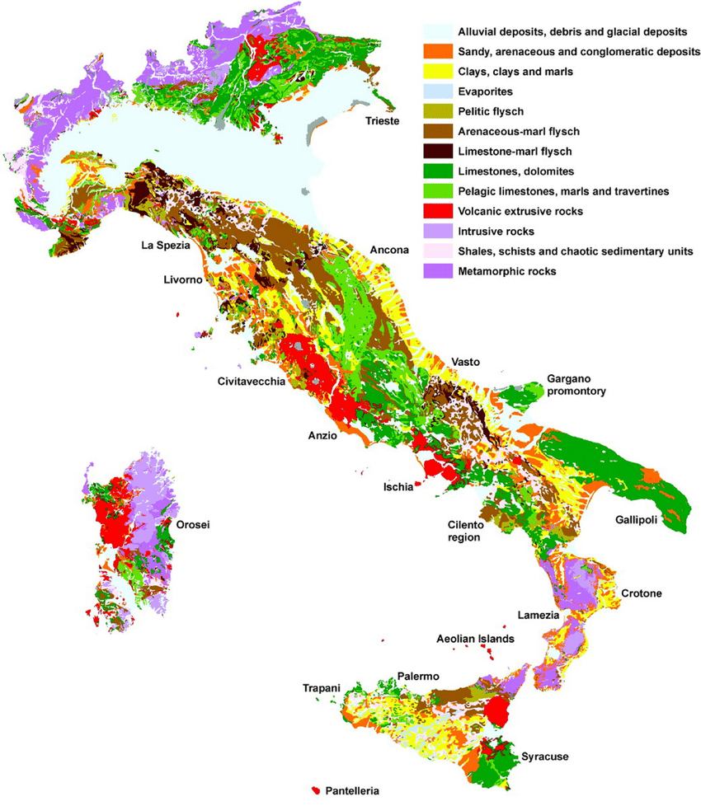
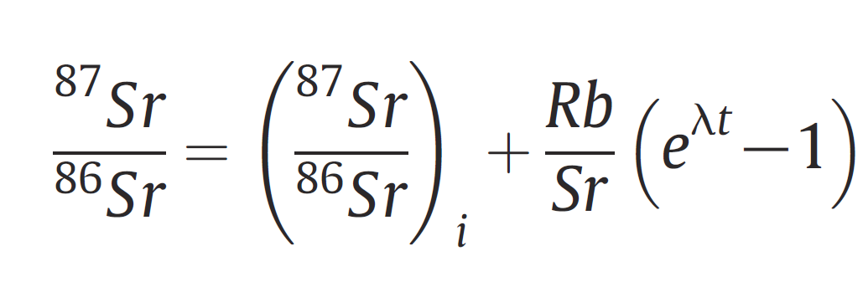
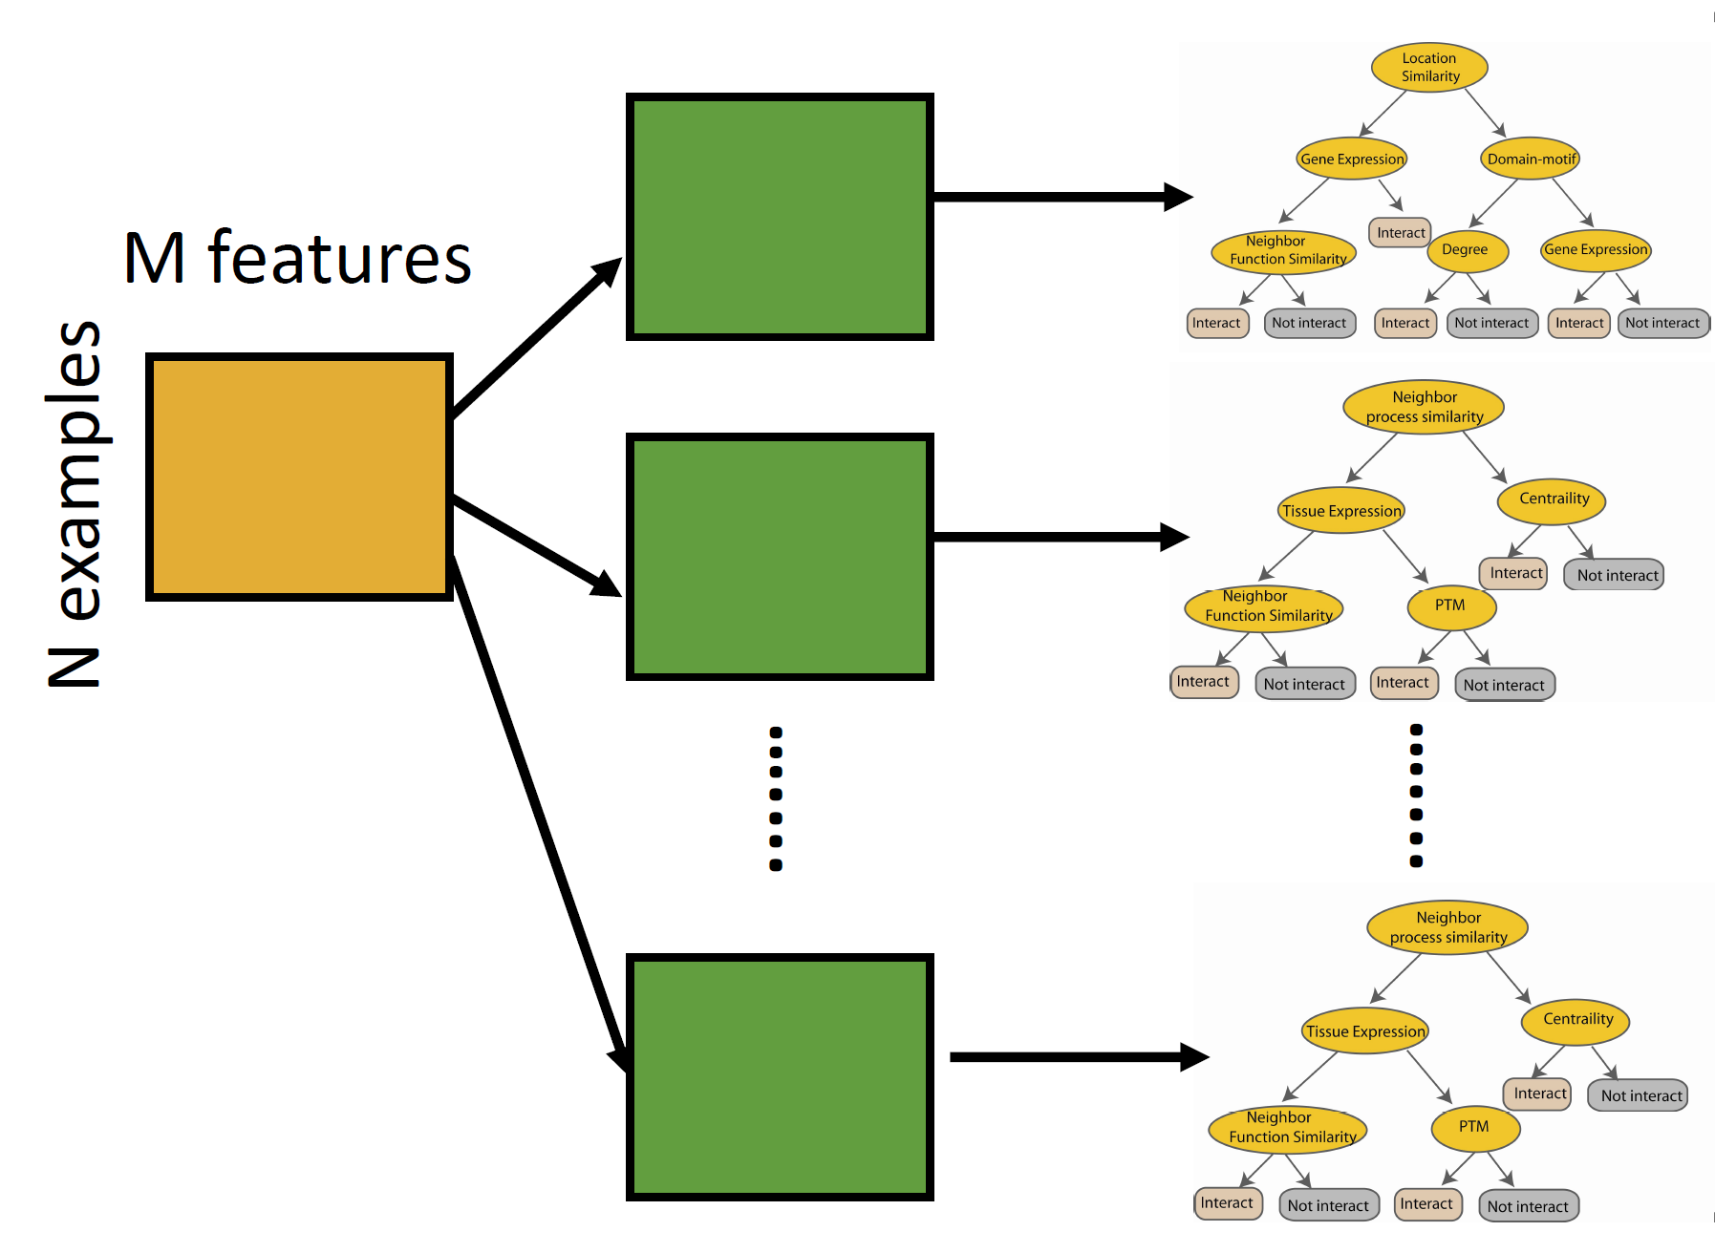
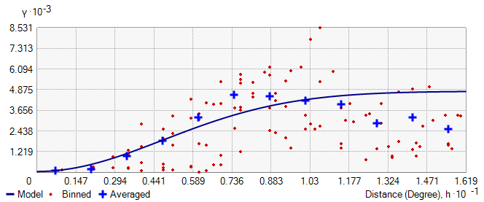

Slide 11
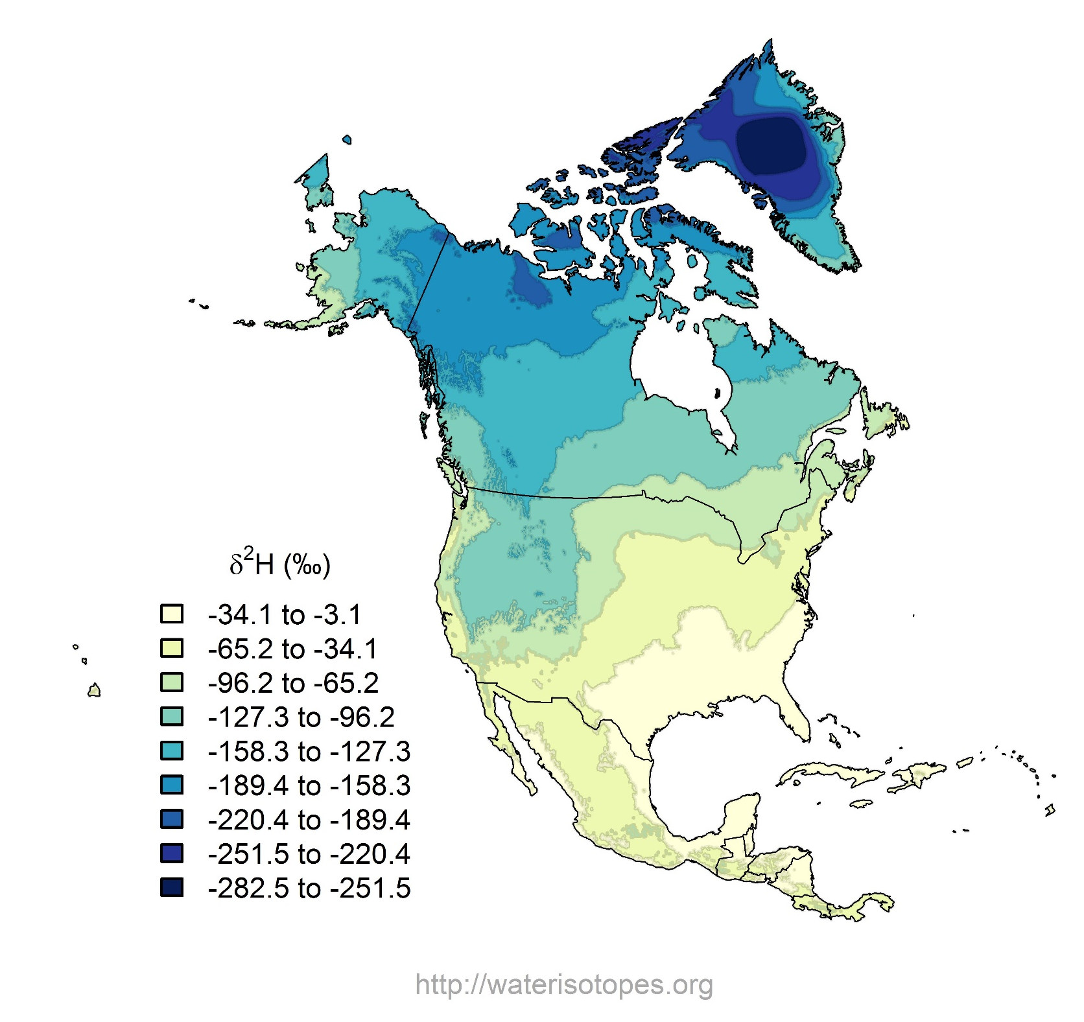

Slide 12



Slide 13
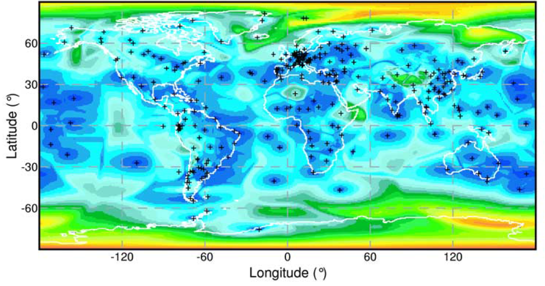
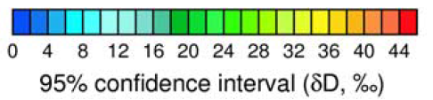
Bowen and Revenaugh, 2003, WRR

Slide 14
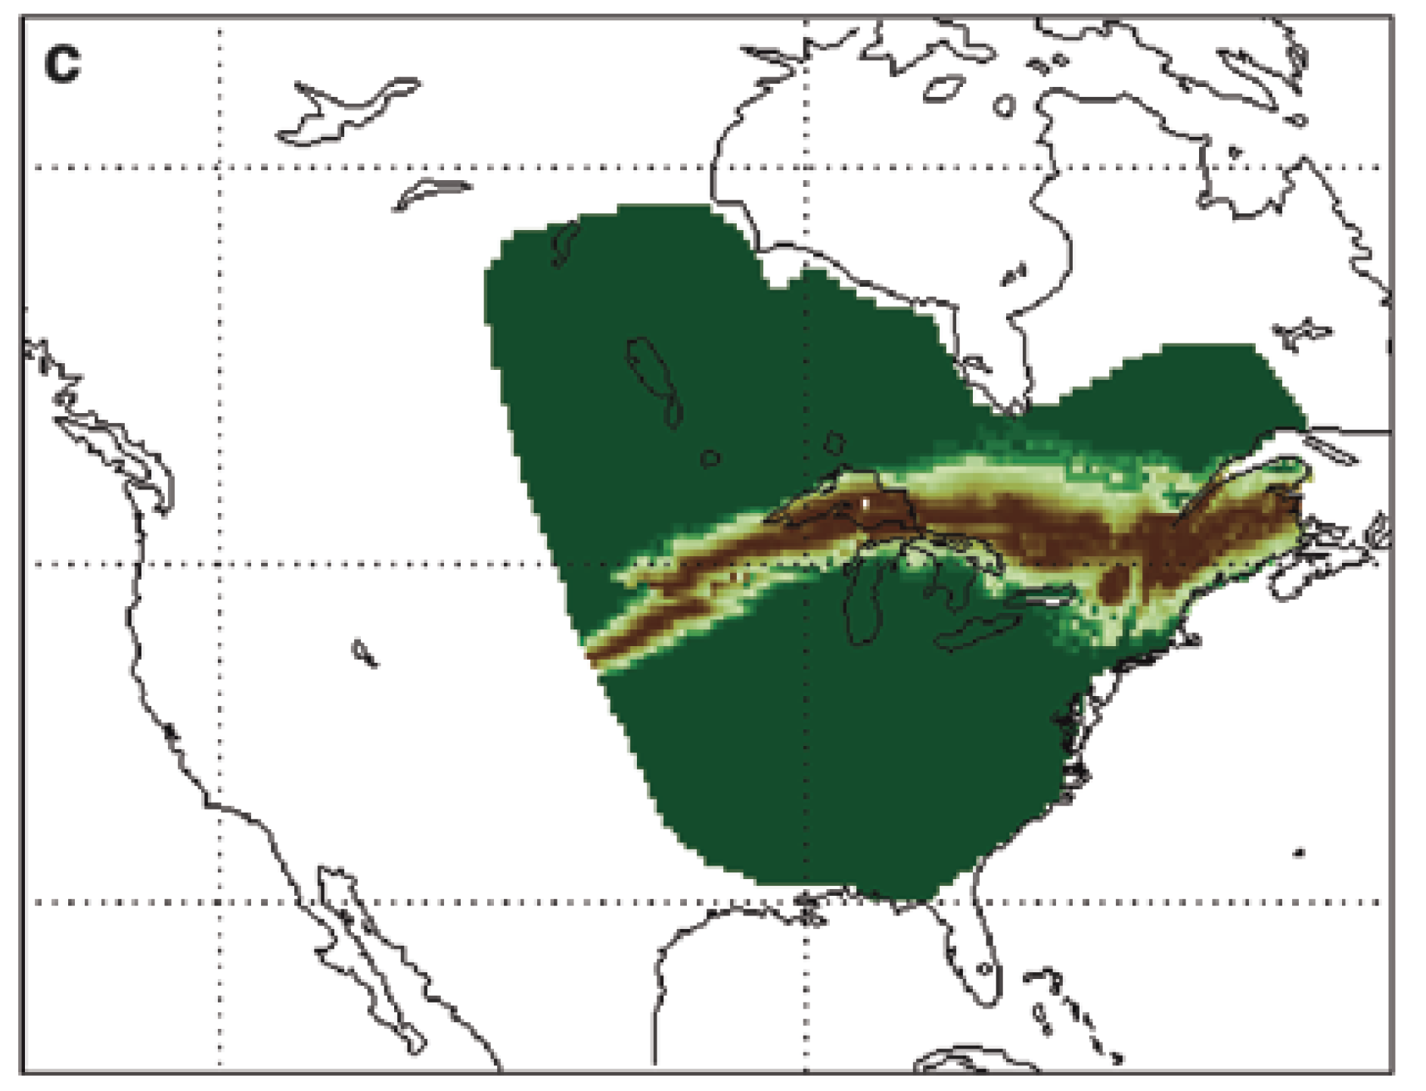
Inferring Origin
Origin
Models

Slide 15
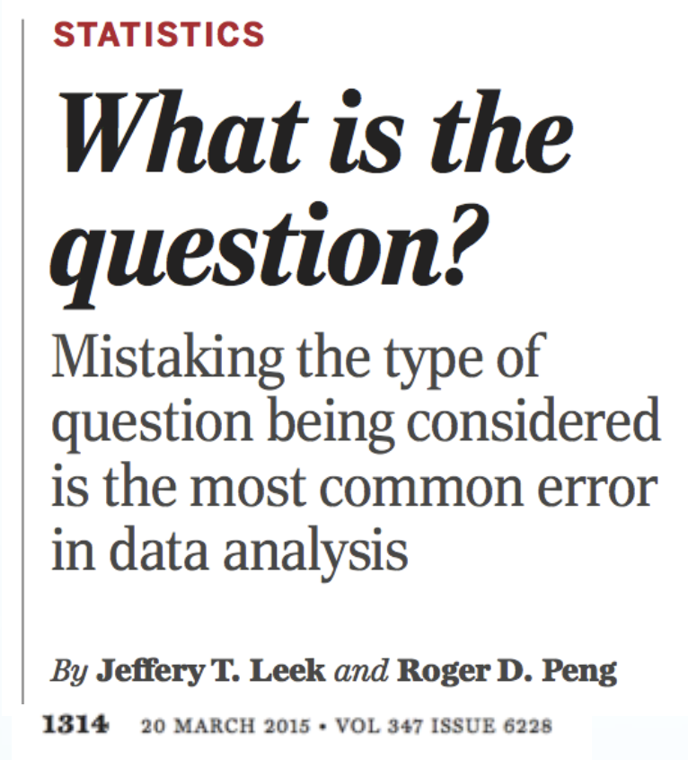
Where could (or couldn’t) the individual have originated?
Isotope values are non-unique and best suited to probabilistic analysis
Probability that a location is the origin
Multiple locations may have high probability!
Key decisions
Constraining the search image
Defining meaningful ‘locations’

Slide 16
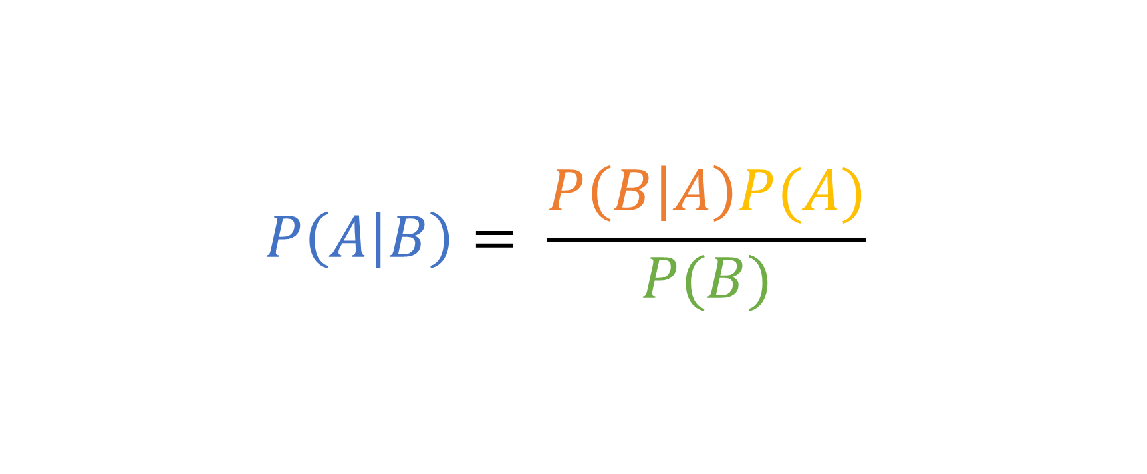
Bayes’ Theorem
$$P\left(A | B\right)= \frac{P\left(B | A\right)P(A)}{P(B)}$$
What we thought we knew
Our new evidence
A: The Model
B: The Data
Our
interpretation
The non-uniqueness of the evidence

Slide 17
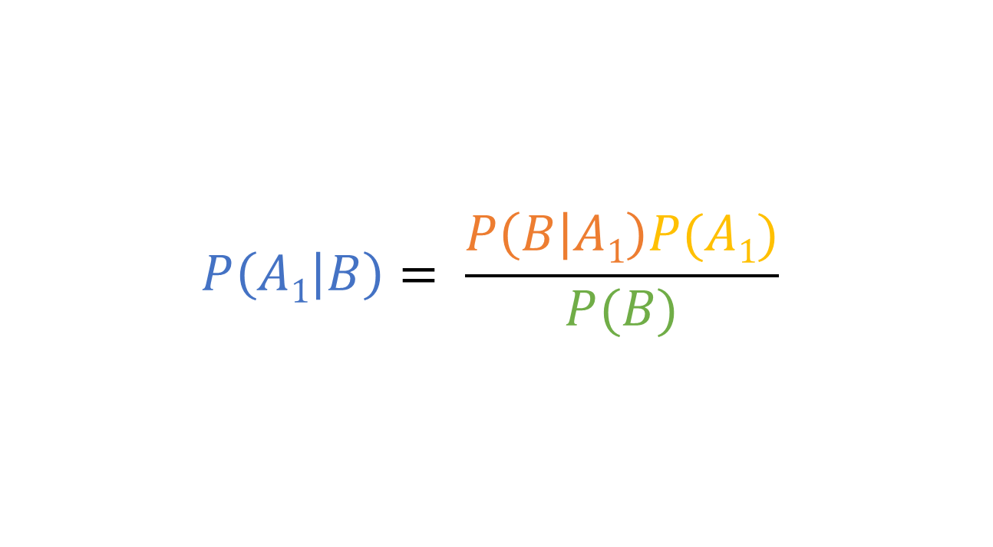
Bayes’ Theorem
Probability of the observed isotope value at location A₁
$$P\left(A1 | B\right)= \frac{P\left(B | A1\right)P(A1)}{P(B)}$$
Any external information about origin A₁
A₁: Sample is from A₁
B: The Data
Probability that A₁ is the origin
Probability of seeing this isotope value

Slide 18
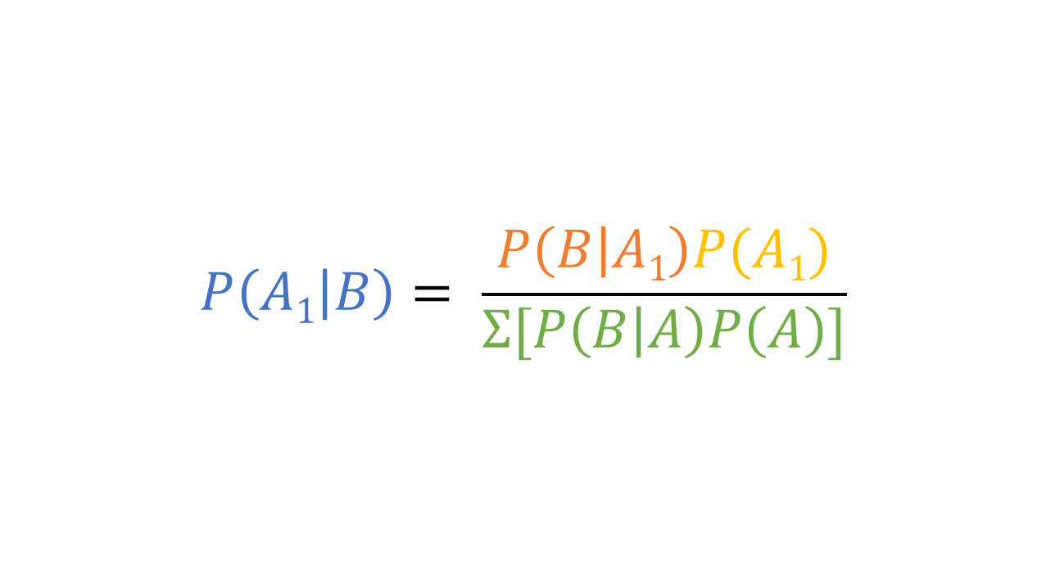
Bayes’ Theorem
Probability of the observed isotope value at location A₁
$$P\left(A1 | B\right)= \frac{P\left(B | A1\right)P(A1)}{Σ[P\left(B | A\right)P\left(A\right)]}$$
Any external information about origin A₁
A₁: Sample is from A₁
B: The Data
Probability that A₁ is the origin (relative to all hypothesized locations)
Total probability across all hypothesized origins

Slide 19
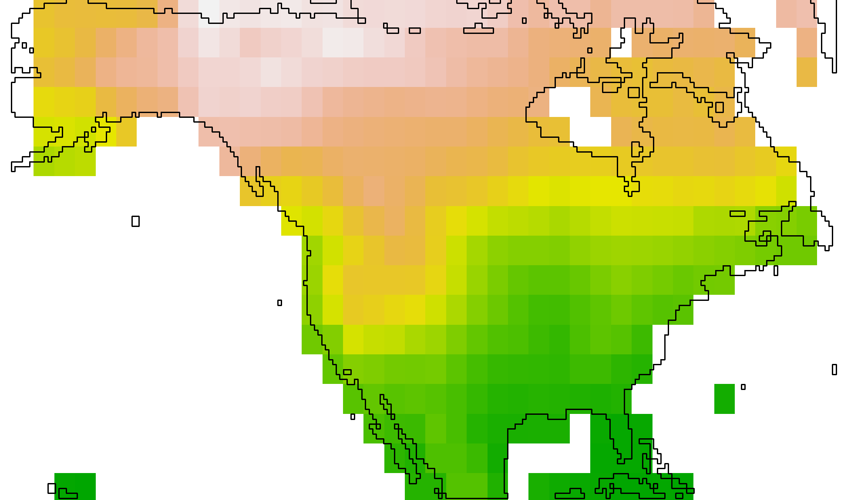
Many (all possible?) hypotheses

Slide 20

assignR
https://bit.ly/assignR4anthro

Slide 21
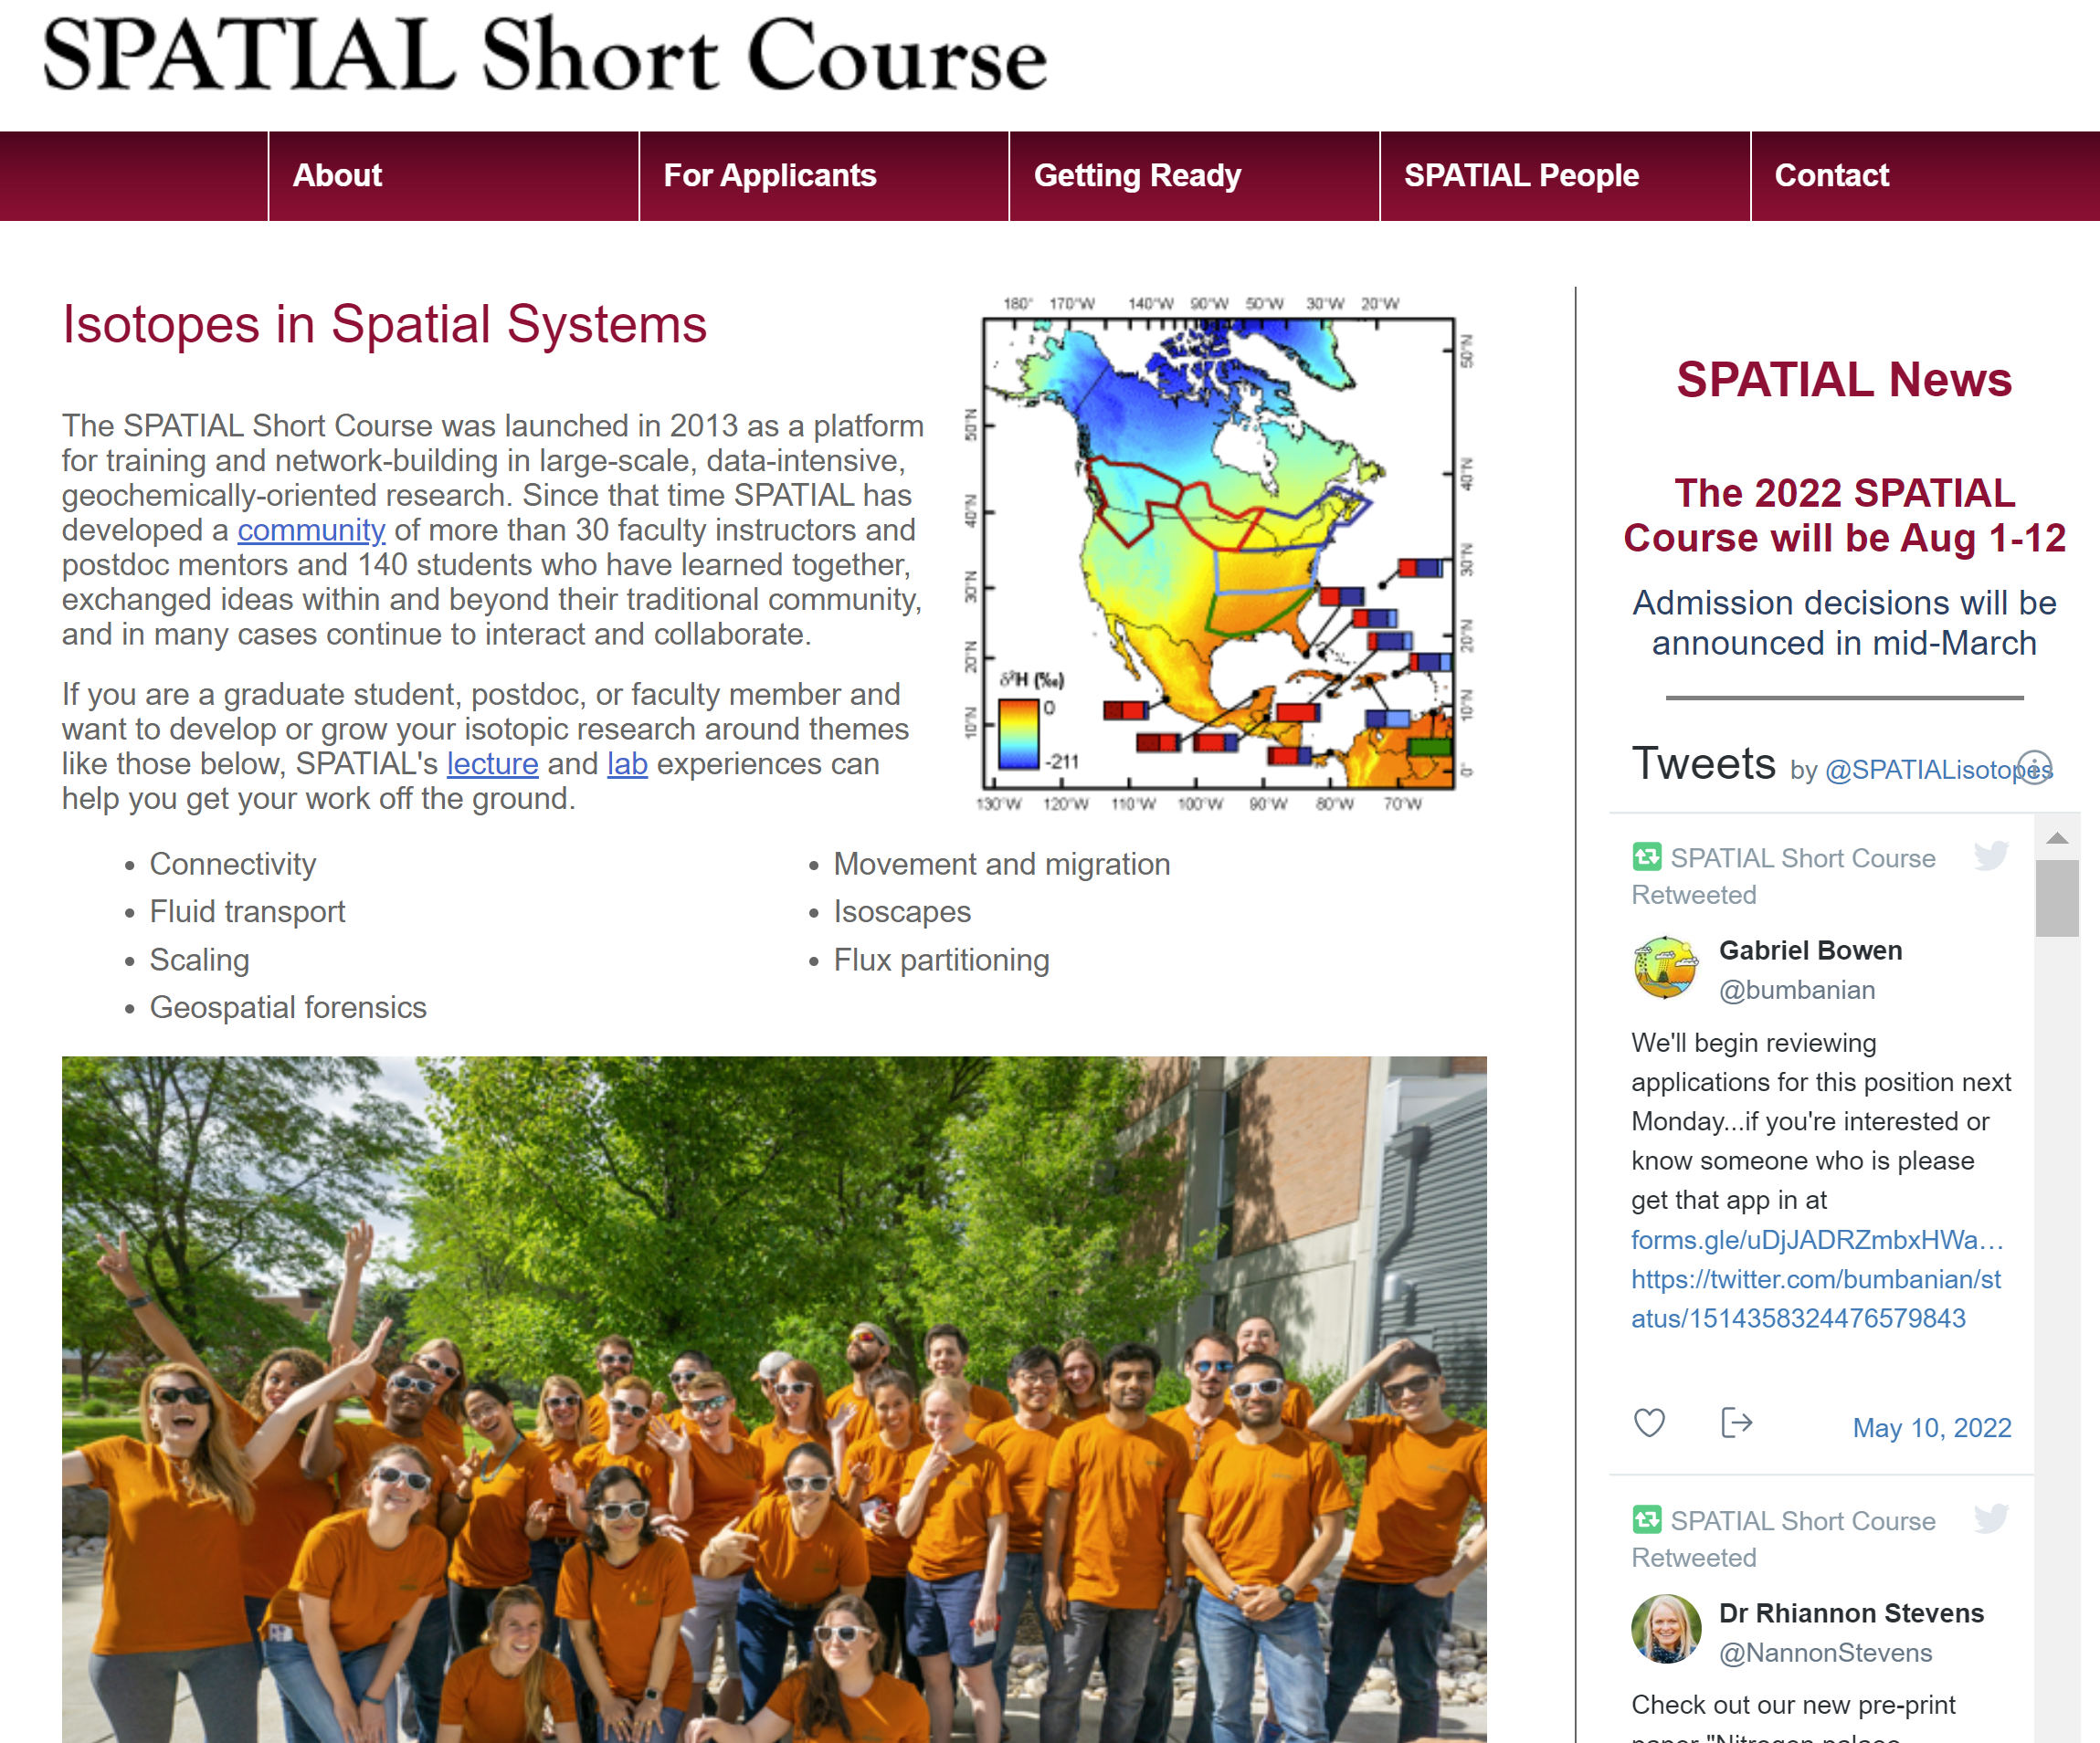
https://itce.utah.edu/spatial.html

